Slide 1

DACPro – Online Quiz and Exam System
This project is designed as an online MCQ-based practice
platform for DAC students, providing a structured environment
to practice and take quizzes across different subjects
Presented by:
Gaurav Hegade
Pratik Khairwar
Shweta Medhe
Srushti Naphade
Tanishqa Sahu

Slide 2

Introduction: The Online ExamAnd Quiz
The landscape of education has dramatically shifted towards digital platforms, making online quizzes and exams indispensable for efficient and scalable assessment.
Online learning has become a global standard, requiring robust assessment tools.
CDAC's PG-DAC program demands frequent, structured quizzes to reinforce learning.
Traditional manual evaluation systems are time-consuming, prone to errors, and lack immediate feedback.

Slide 3
Project Overview: DACPro
DACPro is an intuitive online system designed for quizzes and exams, streamlining the assessment process for both students and administrators.
1
2
3
Student Registration
Subject Selection
Quiz Attempts
Users create secure accounts to access the platform.
Students choose specific subjects or modules for quizzes.
Attempt quizzes with various question types and time limits.
4
Instant Scoring
Receive immediate results and performance feedback.

Slide 4




Problem Statement
Current assessment methods face significant hurdles that hinder effective learning and administrative efficiency.
Manual Evaluation
Fragmented Platforms
Slow, error-prone, and provides delayed feedback to students.
Lack of a unified system leads to inconsistencies and data silos.
Limited Tracking
Scalability Issues
Difficulty in monitoring student progress and identifying areas for improvement.
Inability to efficiently handle a growing number of students or complex assessments.

Slide 5
Key Objectives: Guiding DACPro's Development
Our project is driven by clear objectives aimed at delivering a secure, efficient, and comprehensive assessment solution.
Secure Authentication
Implement robust JWT authentication to protect user data and ensure secure access.
Subject-Wise Quizzes
Enable students to attempt quizzes categorized by specific subjects and modules.
Instant Evaluation
Provide immediate scoring and feedback upon quiz completion.
Progress Tracking
Offer detailed performance analytics for students to monitor their learning journey.
Makes Students DAC CCEE Exam Ready
A focused practice platform designed to strengthen concepts, improve speed, and boost confidence for CCEE exams.

Slide 6
Software Requirement Specification (SRS)
The SRS outlines the essential functional and non-functional requirements that define DACPro's capabilities and performance.
Functional Requirements
Non-Functional Requirements
User registration
Quiz attempt interface with timer and navigation.
Automated scoring and result display.
User profile management & progress tracking.
Performance: Rapid quiz loading and instant result generation.
Security: JWT authentication, secure data storage, and access controls.
Usability: Intuitive UI/UX for seamless navigation.
Reliability: High uptime and data consistency.

Slide 7

System Architecture: Blueprint of DACPro
Frontend
Responsive React js
Cloud Deployment
Client-Server Architecture
Backend
Azure scalable infrastructure
ASP.NET Core MVC server
Authentication
Database
JWT-based secure tokens
MS SQL relational storage
DACPro employs a robust client-server architecture, ensuring secure communication and scalable operations through cloud-ready design.
Client-Side: React js for responsive user interface.
Server-Side: ASP.NET Core MVC handles business logic and API endpoints.
Database: MS SQL for reliable data storage of users, questions, and results.
Authentication: JWT for secure, stateless user authentication.
Cloud Deployment: Designed for easy deployment and scaling on AWS infrastructure.

Slide 8
System Modules: Building Blocks of DACPro
DACPro is structured into distinct modules, each contributing to the system's overall functionality and user experience.
User Authentication
User Profile & Progress
Manages user registration, login, and secure session handling via JWT.
Allows users to manage their profiles and track quiz performance over time.
Question Bank
Evaluation & Result
Stores and manages a diverse collection of quiz questions, including free and premium tiers.
Automates quiz scoring, generates instant results, and provides detailed feedback.

Slide 9
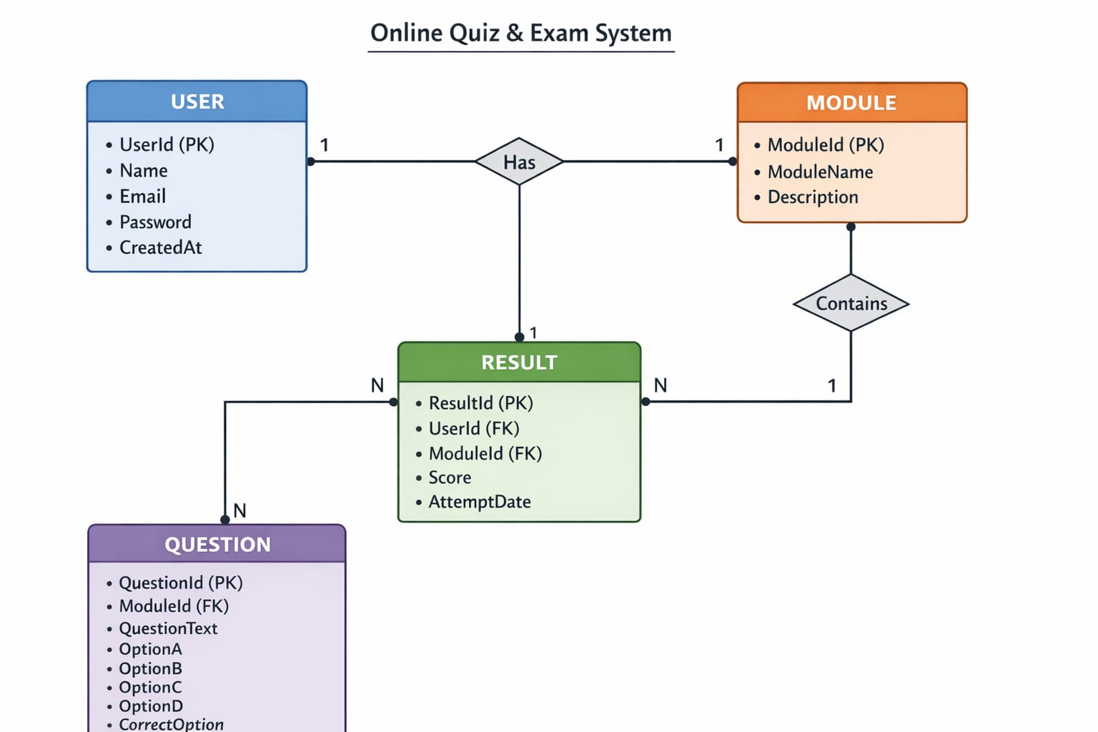
ER Diagram

Slide 10
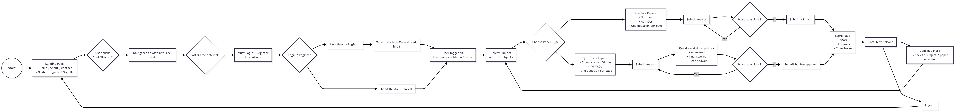
Activity

Slide 11
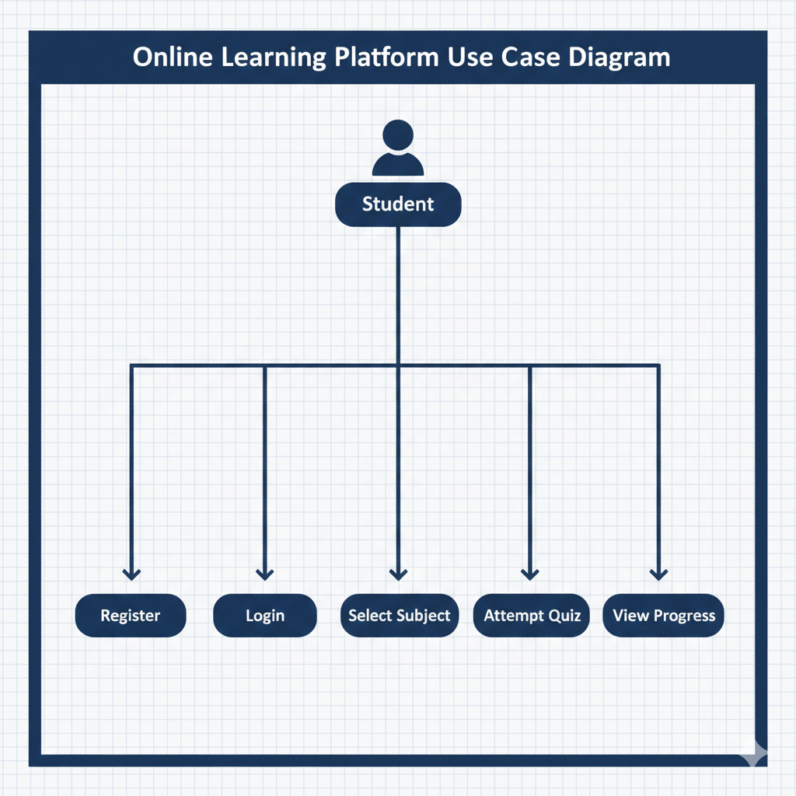
Use Case Diagram
The system is designed around a Student actor who interacts with several core modules to manage their learning journey. Key functionalities include:
Access Management: Students must Register and Login to access the platform's features.
Learning Content: Users can Select Subjects and Attempt Quizzes associated with those topics.

Slide 12
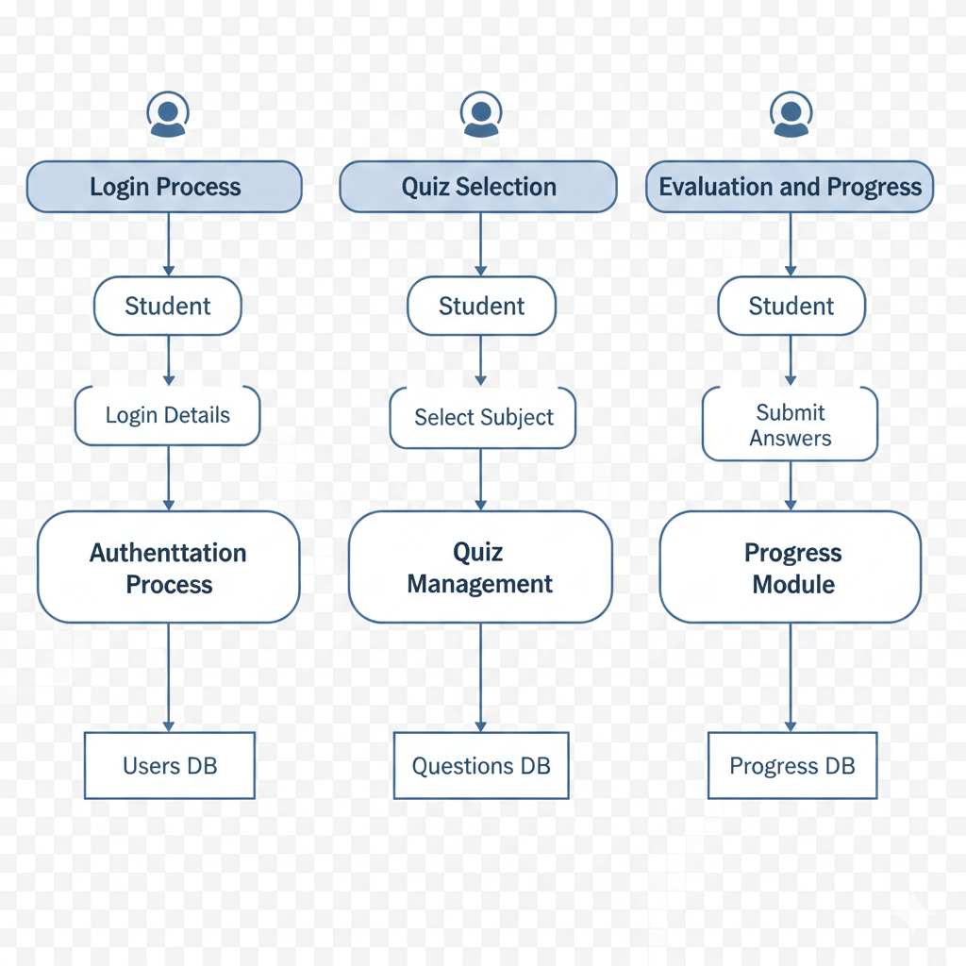
Flow Diagram
Presentation Layer: Built with React and standard web technologies (HTML/CSS/JS) to provide an interactive user interface.
Application Layer: Uses ASP.NET Core Web API to handle business logic, including user management and quiz evaluation.
Data Layer: Utilizes MS SQL Server for persistent storage, managing user profiles, course content, and transaction records.

Slide 13
Conclusion
DACPro provides a robust and user-friendly online assessment platform specifically designed for the CDAC DAC curriculum. By automating key
processes such as user authentication, quiz management, and evaluation, the system significantly reduces manual effort while maintaining
security through JWT-based authorization. The platform's cloud-ready architecture ensures scalability on services like AWS, while real-time
evaluation and progress tracking offer students a structured and interactive environment to improve their learning outcomes.
The platform’s robust, cloud-ready architecture ensures it can scale reliably on services like Azure while providing students with
real-time tracking to actively monitor and improve their learning progress. By combining structured design with a user-friendly
interface, DACPro delivers an enhanced educational experience that effectively supports the CDAC DAC curriculum.

Slide 14
Future Scope: Evolving DACPro
DACPro's future development will focus on expanding its capabilities, enhancing security, and improving user experience through these key initiatives.
Mobile App Development
AI-Powered Analytics
Extend DACPro to Android and iOS platforms for enhanced accessibility and convenience.
Integrate AI to provide personalized performance insights and tailored learning recommendations.
Live Proctoring Feature
Advanced Admin Dashboards
Implement webcam monitoring and AI-based proctoring for improved exam security.
Enhance administrator view with graphical reports, charts, and detailed performance analysis.
Premium Subscription Model
Multi-Language Support
Introduce monthly or yearly subscription plans for access to premium features and content.
Expand platform accessibility and reach a wider user base by adding support for multiple languages.

Slide 15
References
Microsoft Documentation – ASP.NET Core MVC Framework
https://learn.microsoft.com/aspnet/core
JSON Web Token (JWT) Official Documentation
https://jwt.io
MSSQL Official Documentation
https://dev.mssql.com/doc
Amazon Web Services (AWS) Cloud Computing Documentation
https://docs.aws.amazon.com
W3Schools – Web Development Tutorials (HTML, CSS, JavaScript)
https://www.w3schools.com
OWASP Security Guidelines for Web Applications
https://owasp.org

